Slide 1







CO-EVOLVE4BG kick-off TECHNICAL DAY
Co-evolution of coastal human activities & Med natural systems for sustainable tourism & Blue Growth in the Mediterranean
Pilot actions of CO-EVOLVE,
results and good practices for experiences transferability
Christian Marasmi
Directory General of Territory and Environment Care
Soil and Coast Protection and Land Reclamation Service
Co-Evolve4BG Associated Partner
CO-EVOLVE WP4 Leader
Gammarth - Tunisia
19/09/2019

Slide 2
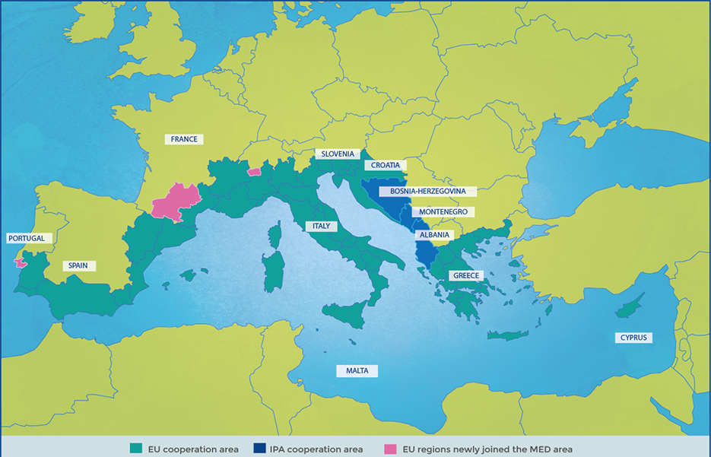
Pilot Areas distribution and identification
AREAS
Alexandroupoli/ Makri area & Thassos/ Keramoti area
Cattolica (RN) port of Cattolica &
Comacchio-Lido di Spina (FE- Po Delta park RER)
Rosolina Mare area &
Polesine Camerini Delta Po area
Port of Valencia
Maguelone/Frontignan area &
Vias/Vendre Orb Delta area
Kaštela bay (SD County)
Neretva Delta (DN County)
3
2
5
6
7
1
4

Slide 3
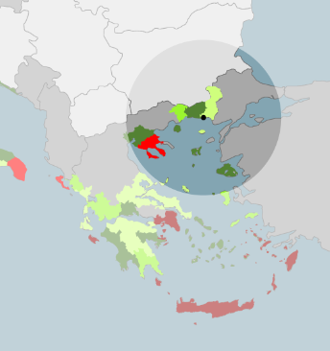
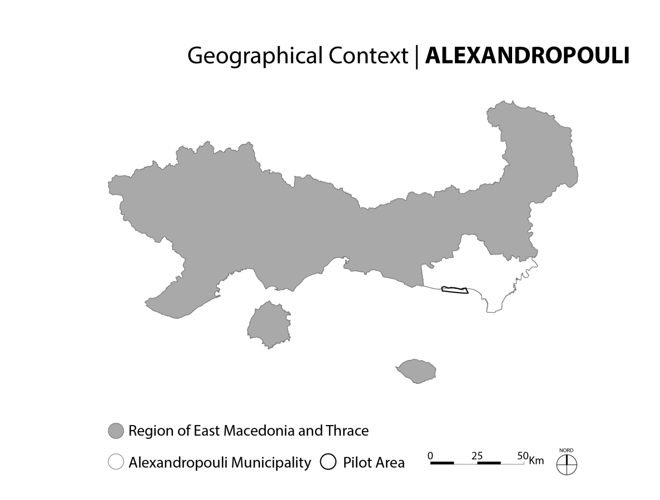
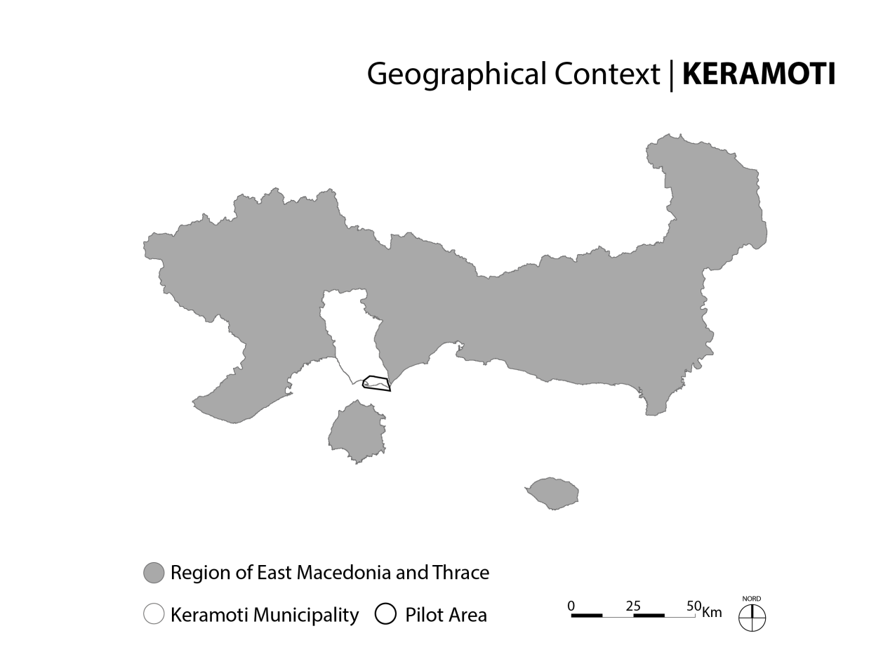
PA1- Alexandroupoli/ Makri & Thassos/ Keramoti
Threats / needs identified in strategic level
Selection of pilot areas
Communication and consultation with key stakeholders
Identification of threats and enabling factors (CO-EVOLVE methodology – project implementation phase)
Public consultations, meetings, on-site visits for the identification of specific actions
Selection of specific measures and actions of the 2 local Action Plans and link with existing financing schemes and instruments.
PHASES
INCEPTION
IMPLEMENTATION
OPERATIVE

Slide 4
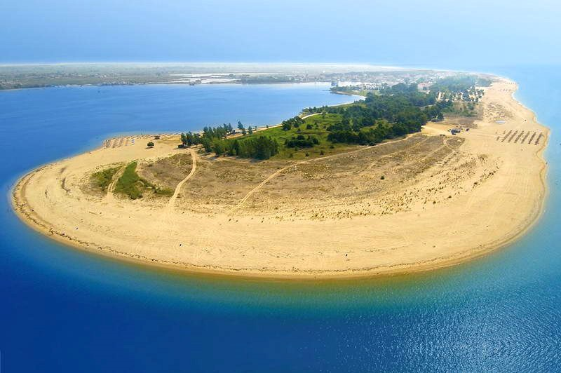
PA1- Actions for local Action Plans
1A
Elaboration of a study for the Integrated Management of the Coastal Zone of Alexandroupolis-Makris
Establishment of a Coastal Erosion Monitoring/ Measuring Mechanism at the Port Authority of Alexandroupolis, covering the coastal front of the study area
Investments in coastal erosion protection measures
Enhancement of Protected Areas Management Bodies for the management of natural environment and biodiversity in the Natura areas of the Region of Eastern Macedonia and Thrace (Nestos-Vistonida Management Body)
Investments for the prevention and management of flood risks
Investments in coastal erosion protection measures in Keramoti
Elaboration of a study for the Integrated Management of the Coastal Zone of Keramoti
1B

Slide 5
PA1 - Financing Schemes linked to the Action Plan
All actions are directly linked to a funding mechanism.
All actions can be supported under invitations co-financed financed by the ERDF (and national funding sources).
REMTH indirectly manages the Regional Operational Programme (ROP) - all proposed actions have a clear link with the ROP’s Priority Axis, relevant Thematic Priorities and Investment Priorities.
An analysis of the current status of the budget available, under the ROP 2014-2020 for specific and relevant to the proposed actions budget has been completed.
Currently there are 3 active invitations funded from the ROP 2014-2020 with available budget.
  ΑΜΘ08 - PREVENTION AND RISK MANAGEMENT MEASURES BY FLOODS - ACTION 5b.9.1
  ΑΜΘ14 - UPGRADING / SUPPORTING TOURISTIC PRODUCT OF THE REGION – ACTION 6c.12.3
  ΑΜΘ23 - PROTECTION AND PROMOTION OF THE ECOSYSTEMS IN THE REGION
There are closed relevant invitations that are directly linked with the proposed measures
  ΑΜΘ25 and ΑΜΘ58 – EQUIPMENT FOR PREVENTION AND RISK AND DISASTARS MANAGEMENT, SUCH AS FIRES AND FLOODS
  ΑΜΘ06 - INTERVENTIONS FOR THE PROTECTION FROM EROSION.

Slide 6
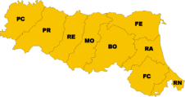
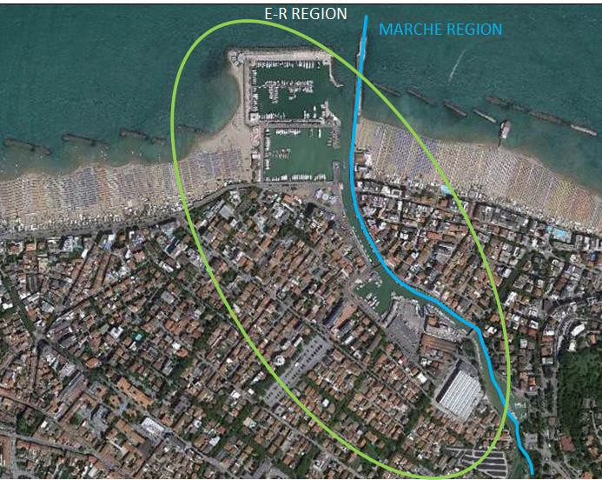
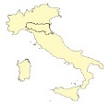
PA2 – Cattolica
A densely urbanized C&M tourism destination, with beach facilities and a multi-purpose river port (fishing, yachting, shipyards, yacht production, shops, restaurants) with very high level of waste production and peculiar by each kind of activity.
Phenomena of siltation from upstream and sand accumulation at the port’s mouth reduce navigation safety, attractiveness and operability of the port, with strong negative impacts on the various tourist and economic activities present in the harbor and the city.
Periodic dredging operations are necessary, strong impact both on the environment and on the budget that the Public Administration must put in balance and spend every year.
Notes:
200 fishermen working with 100 fishing boats
300 berts for yatching /pleasure boats
Ferretti luxury Crafts, group Headquarter and shipyards … how many luxury Yatchs produced in a year?

Slide 7
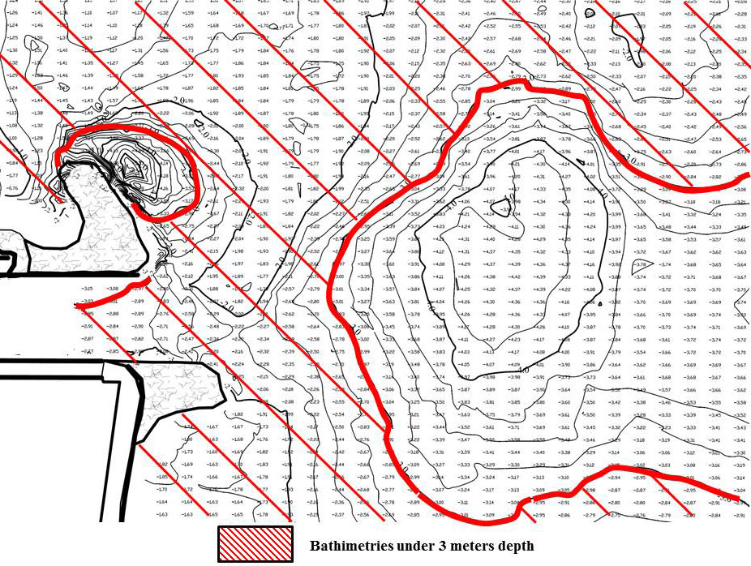
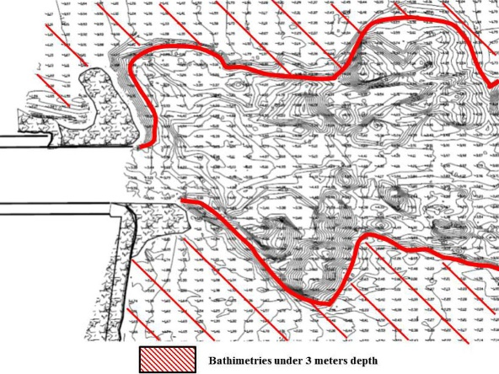
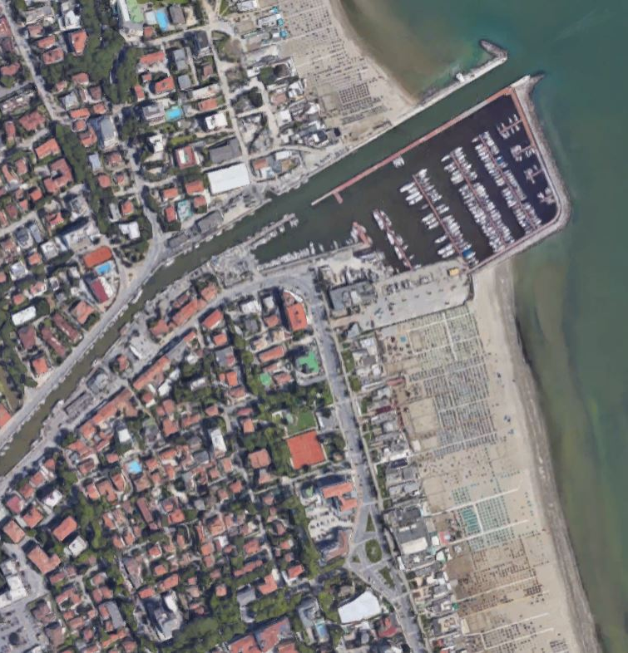
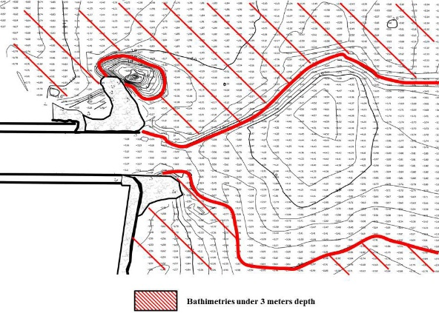

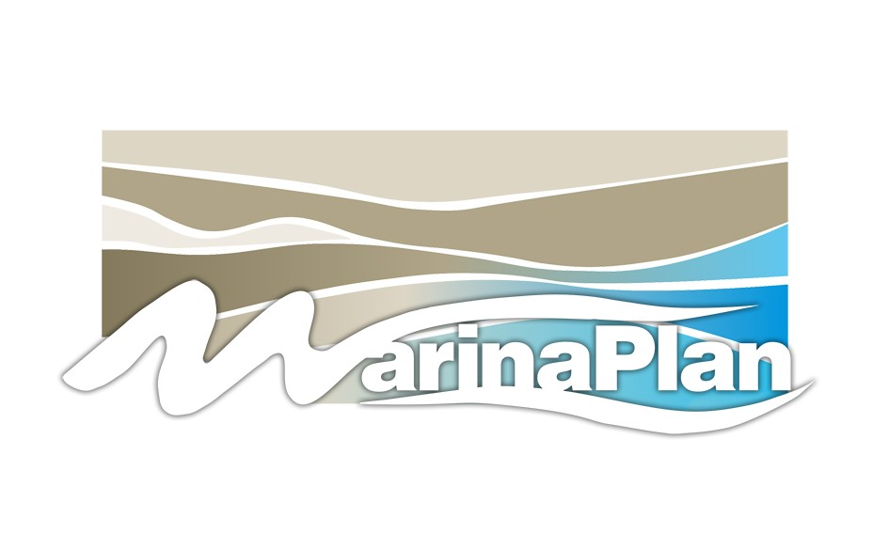
Major issue: silting of port mouth
CERVIA: in 2009 works were completed for extending south and north entrance docks of the port with the aim to contrast the silting phenomena affecting its mouth.
May 2009: just after helixes action operation
First area silting
December 2009: 7 months after helixes action operation
October 2009: 5 months after helixes action operation
Need for a different
solution
Need for a different
solution
Notes:
Silting of port mouths is a major problem for many regional ports (not only Cattolica)

Slide 8
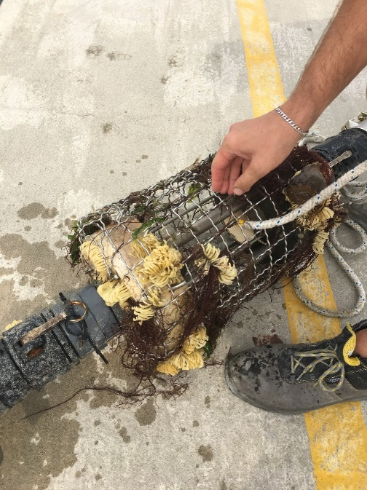
PA2 - The ejector plant
Technology and solution adopted within MarinaPlan (Life+) and Co-Evolve
Port seabed re-modelling plant with Ejectors system is compliant with Good Practices AS-2.2 (IT National Guidelines on coastal protection) concerning installation of permanent devices for sediment transfer or bypass

Slide 9
PA2 - The ejector plant
Technology and solution adopted within MarinaPlan (Life+) and Co-Evolve
The ejector collects the sediment that is naturally settled into its area of influence, and therefore does not introduce or take away anything. Once the plant reaches steady state conditions, the marine ecosystem is no longer modified.
Port seabed re-modelling plant with Ejectors system is compliant with Good Practices AS-2.2 (IT National Guidelines on coastal protection) concerning installation of permanent devices for sediment transfer or bypass
Notes:
Submerged flux of water that, thanks to the venturi effect, collect the suspended sediments and convey them to the discarge pipe

Slide 10
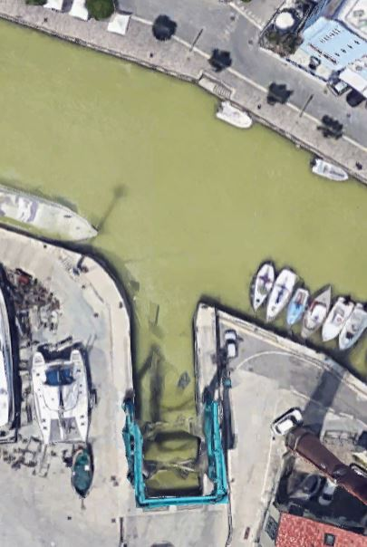
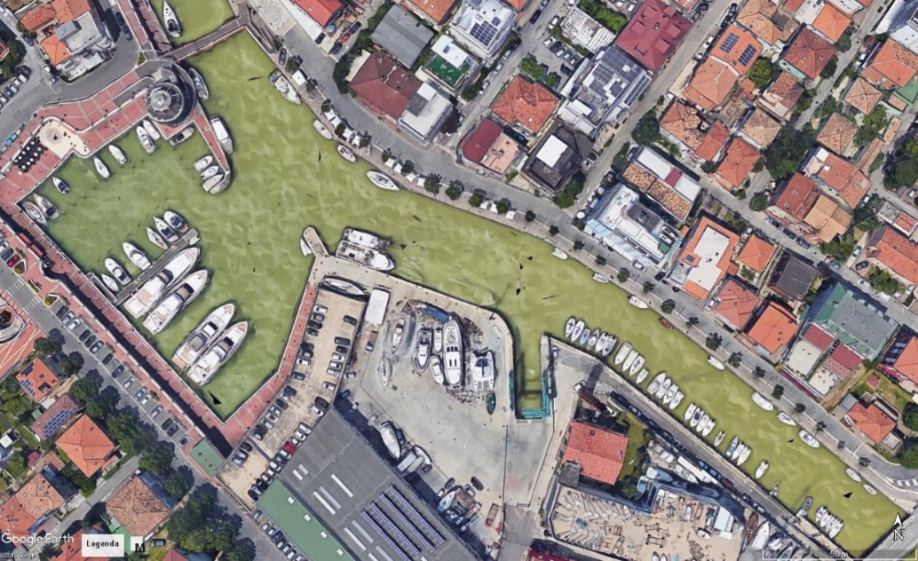
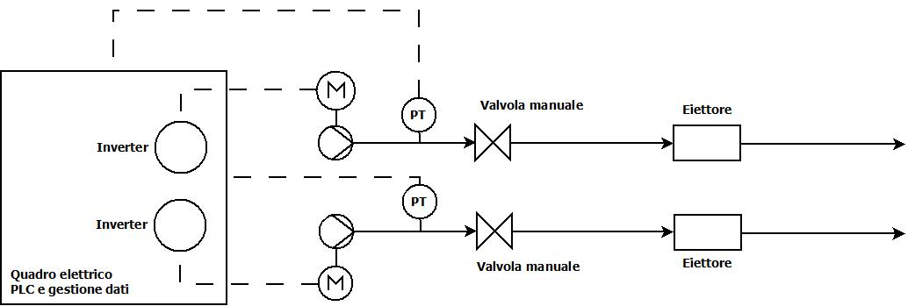
PA2 - The ejector plant
Pilot Area 2a – Cattolica (RN)
The small scale investment
EJECTOR DEVICES
Ejectors position
#2
#1
hauling and launching area
The plant consists of two ejectors, all supplied with pressurized water from a submerged pump. The supplied flow is adjustable, even remotely, by inverter system. The pump regime is programmable by time slot.

Slide 11
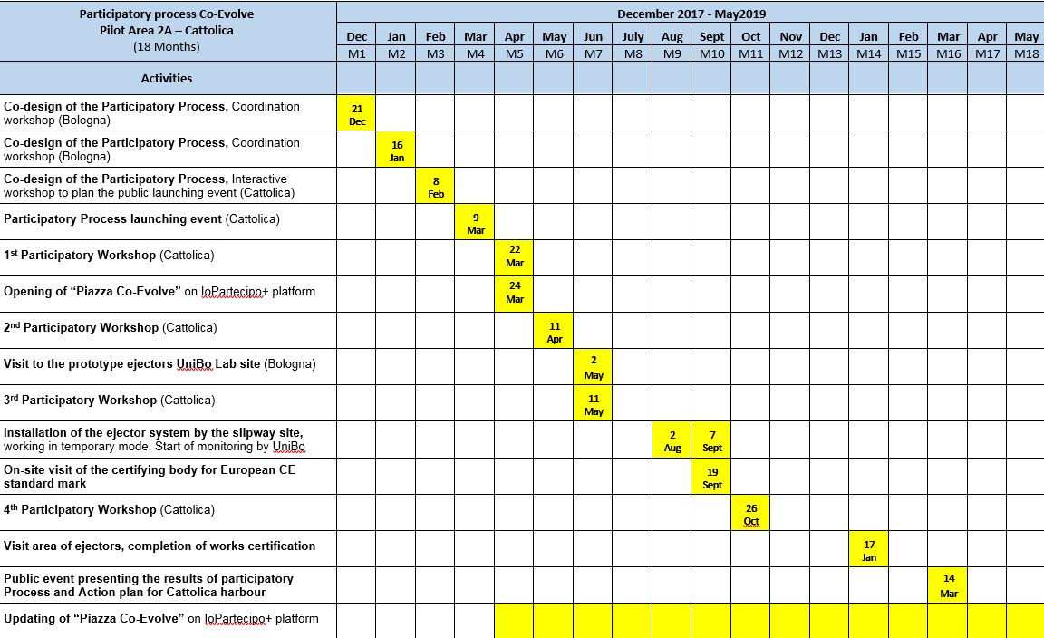
PA2 – Action Plan

Slide 12
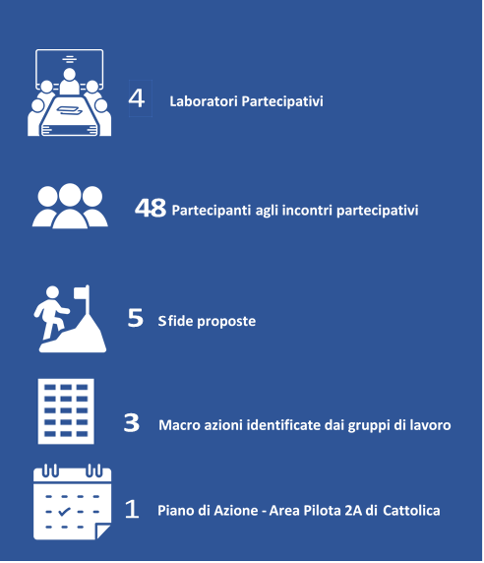
PA2 – Action Plan
Main results, themes and actions individuated in the local Action Plan
Public/Private collaboration for monitoring and sharing maintenance of the seabed of the port (elements for a P/P Memorandum of Understanding), waste management, reduction of river siltation
Sustainable management of the seabed also through innovative solutions (ejectors plant installed in the haulage/launching basin)
Feasibility project for installation of ejectors plants in all the critical points of the port seabed;
Waste differentiated system collection plan, fishermen, shipyards, marinas, urban, and reduction of waste production in the port area;
Reduction of river fine sediment load also through the introduction of opportune soil management measures in agriculture in the river watershed;
Participatory laboratories
Participants
Challenges
Macro actions individuated
by the working groups
Action Plan to be implemented with the collaboration of diverse public and private stakeholders, with specific agreements and memoranda of understanding, for the management, environmental sustainability and re-launch of the Port of Cattolica
Action plan
https://partecipazione.regione.emilia-romagna.it/co-evolve

Slide 13
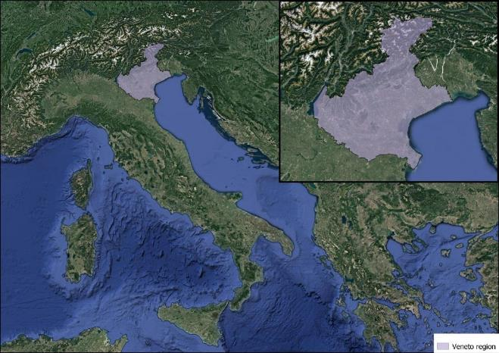
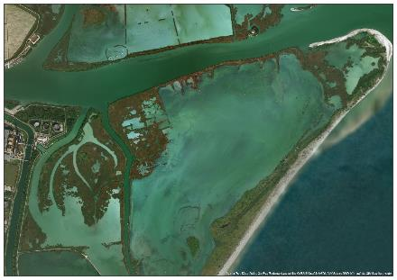
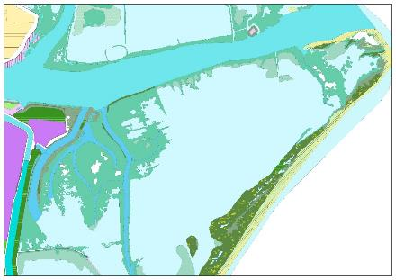
PA3 – Po Delta Park Veneto
Technical Observative Centre – G.I.S. database
One of the project’s component is to develop a cartographic database that contain the following information:
Environmental data
Tourist and advertising data
Technical data, useful for environmental, urban and strategic planning
Performance indicators about project works

Slide 14
PA3 – Po Delta Park Veneto
Technical Observative Center – Catalogue and Cartographic Portal
There are two ways to access the database:
Cartographic Portal: it contains thematic maps created from Po Delta Authority about predefined arguments
Data Catalogue: users can access a catalogue that contains every available data. With this data they can:
  Find interesting information using metadata
  View and download found information
  Compose independently personalized maps that contain information found in the catalogue
  Connect and query data from Partner’s database that contains project common parameter (environmental, touristic, etc...)

Slide 15
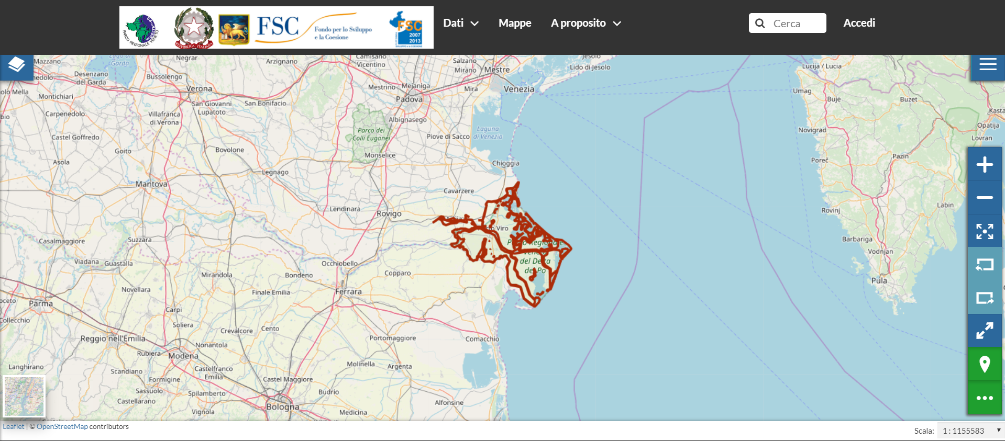
PA3 – Cartographic portal

Slide 16
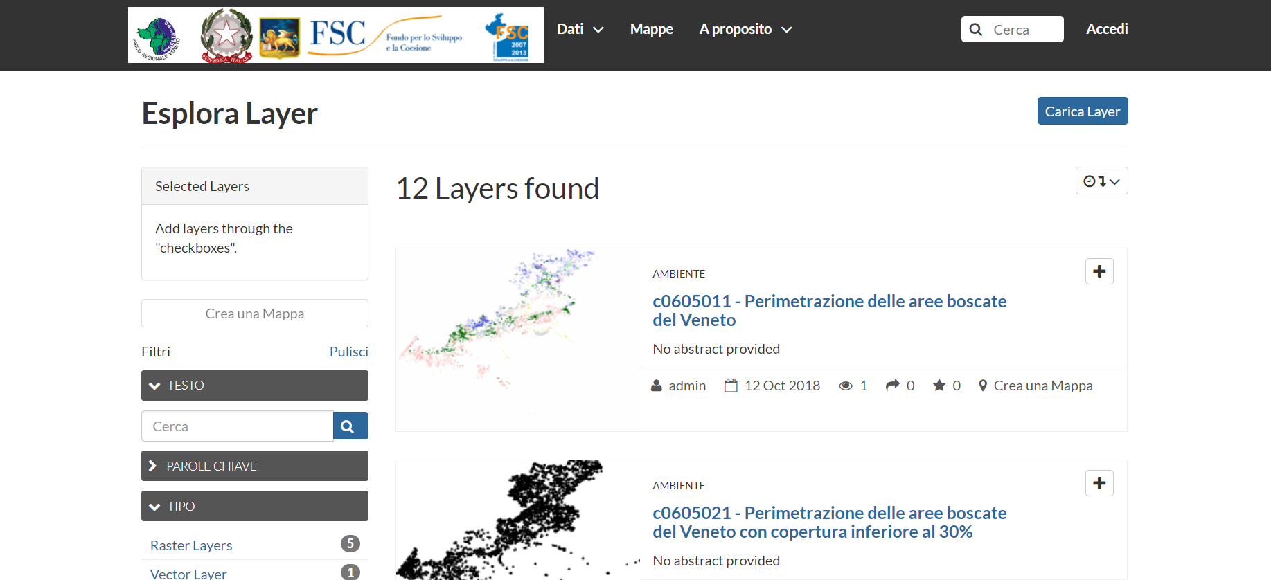
PA3 – Data Catalogue

Slide 17
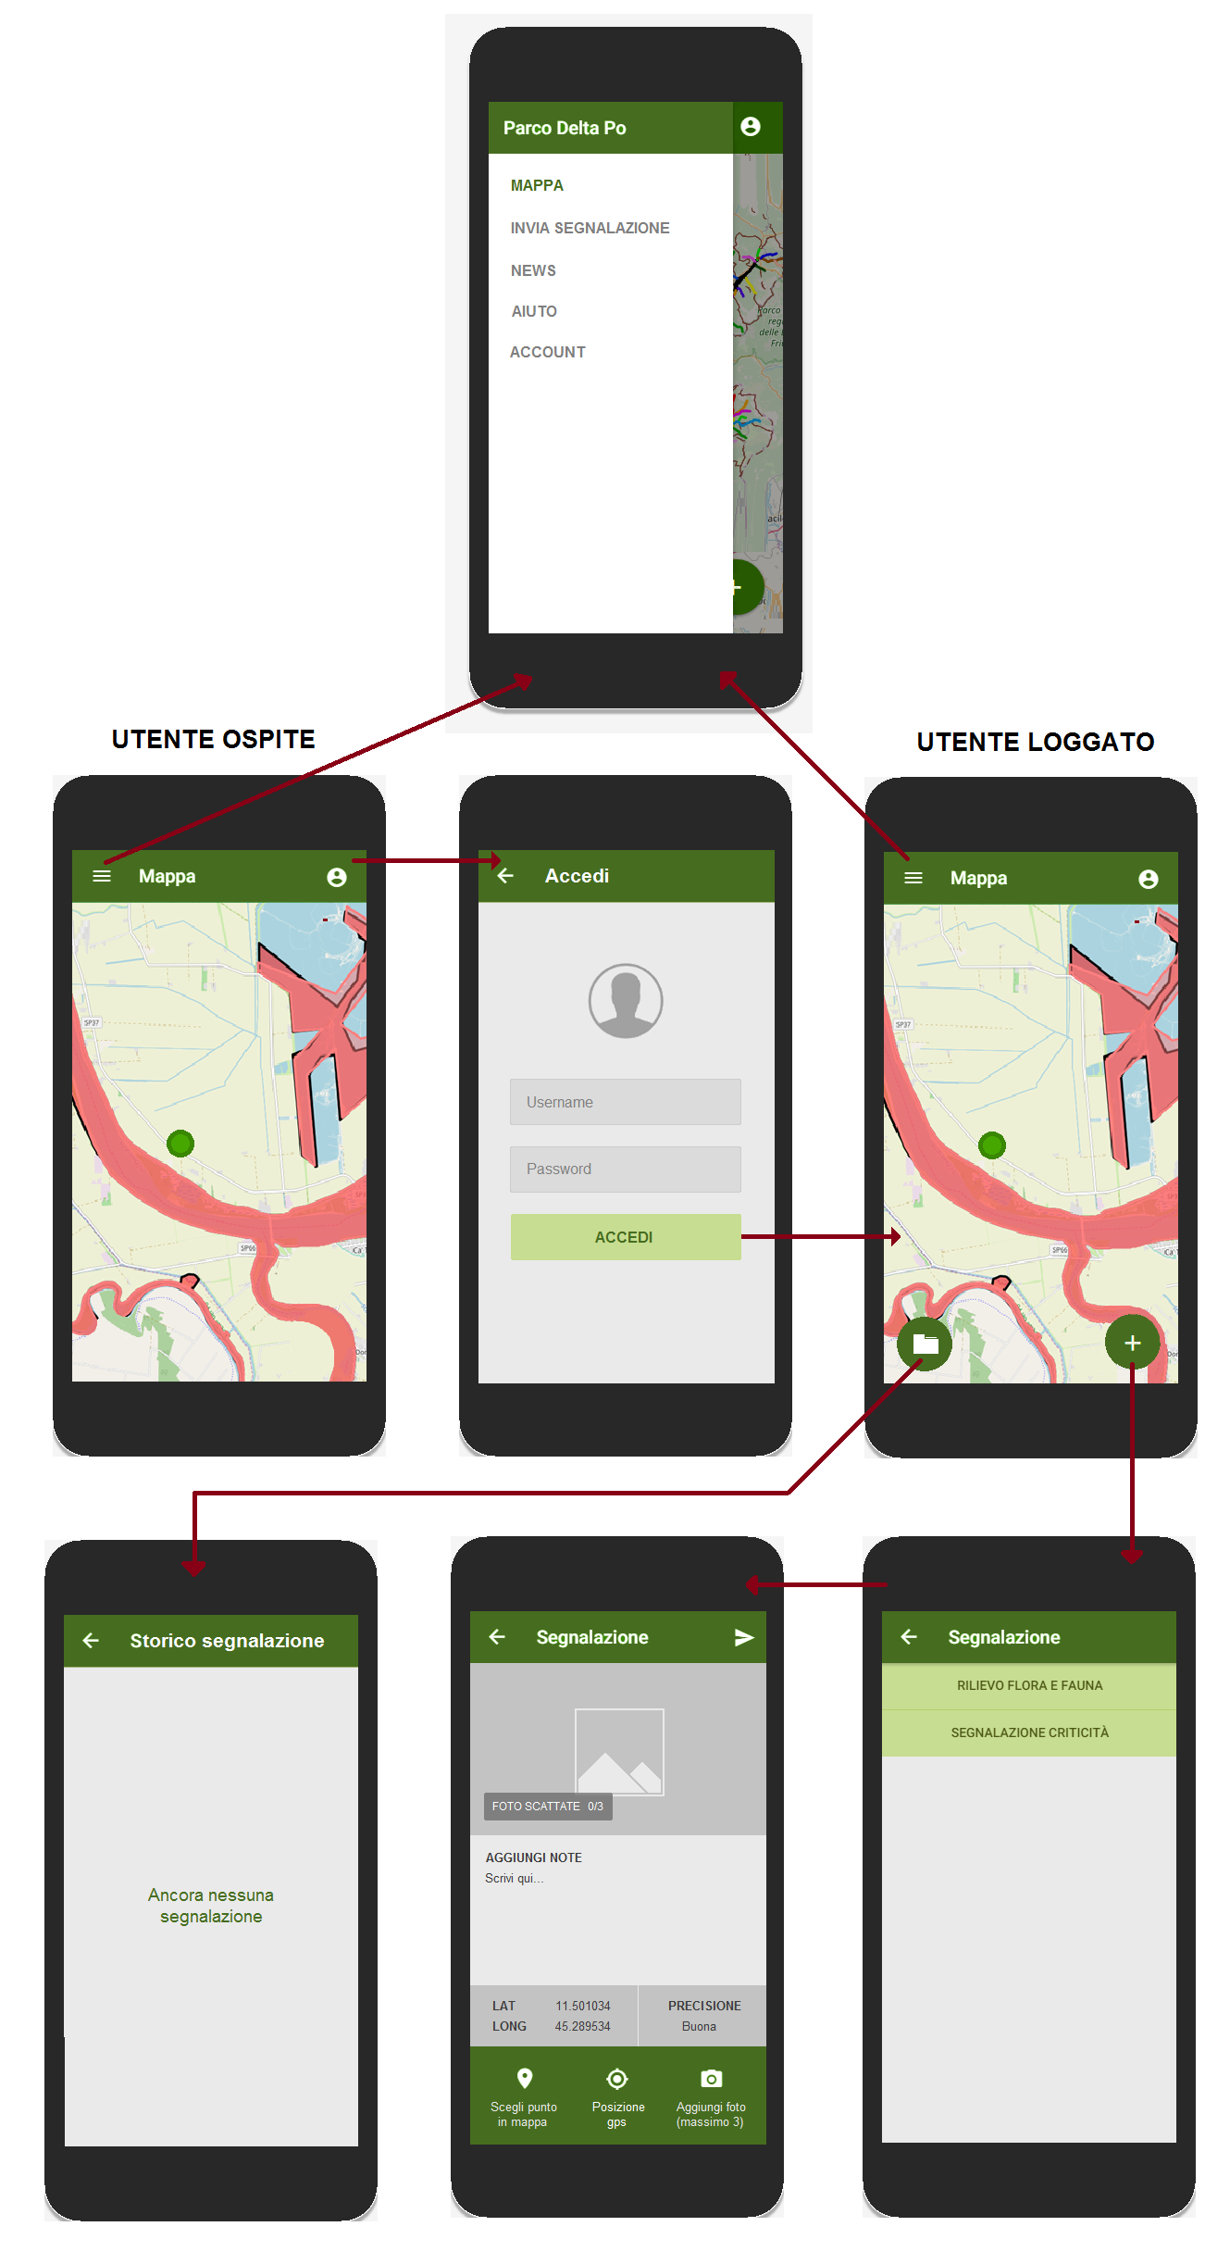
Pilot Areas distribution and identification
IV. Pilot Area Polesine Camerini 3B
Technical Observative Center – Mobile Data Collector
Avaiable on Google Play and IOS App Store a mobile tool to collect reports from users, regarding the data monitored by the observatory.

Slide 18

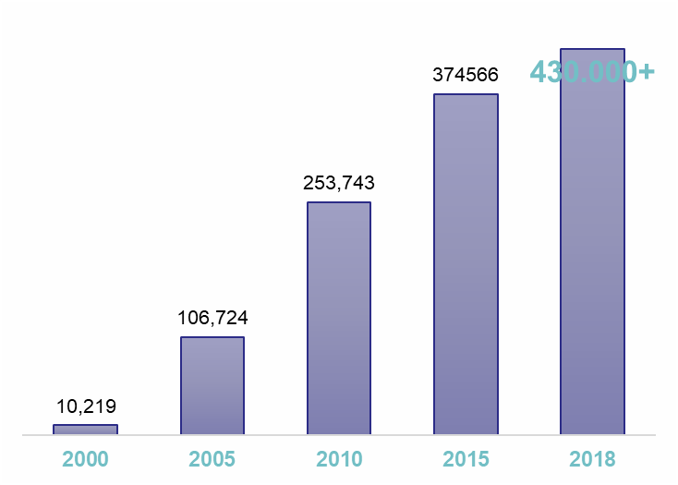
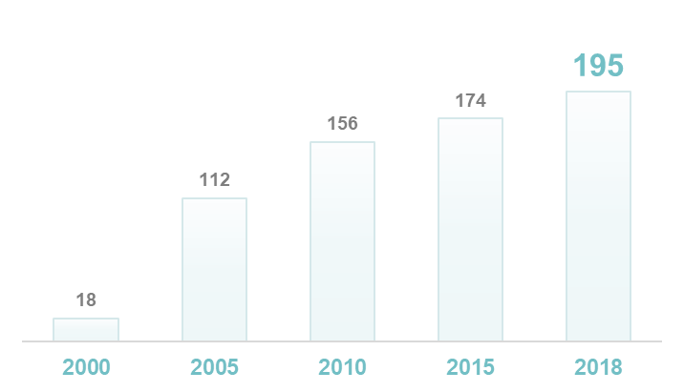
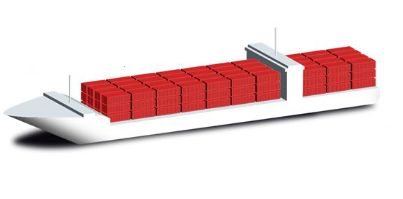


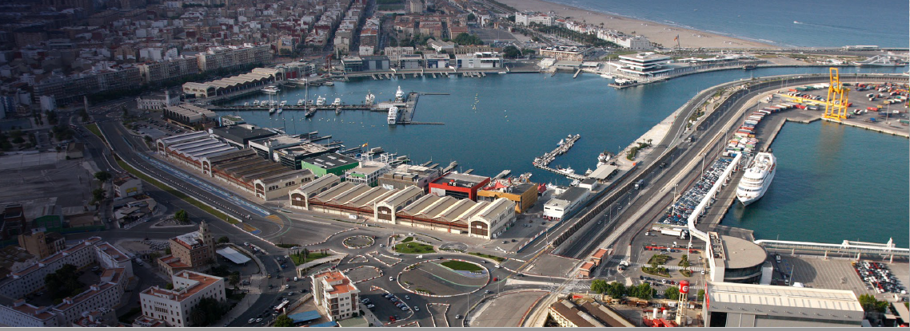
PA4 – Valencia Port
Cruise passengers
Cruise calls
Europe
Spain
and Med
5
4.83 millions TEU
Ferry passengers 616,960
Cruise passengers 412,328

Slide 19
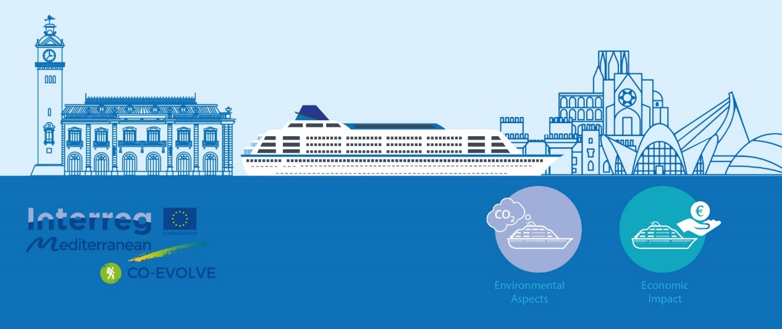
PA4 – Objectives of the pilot action
Identification and measuring of socio-economic and environmental impacts of cruise tourism at Valencia destination, increasing transparency and introducing mechanisms for a permanent dialogue among stakeholder groups.
Defining short, medium and long term objectives/measures aimed at achieving sustainable development of cruise tourism activity in Valencia.

Slide 20
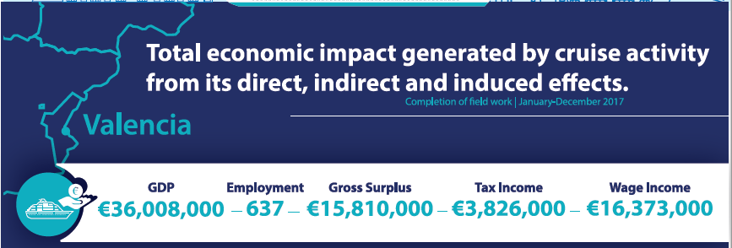
PA4 – Economic impact evaluation

Slide 21
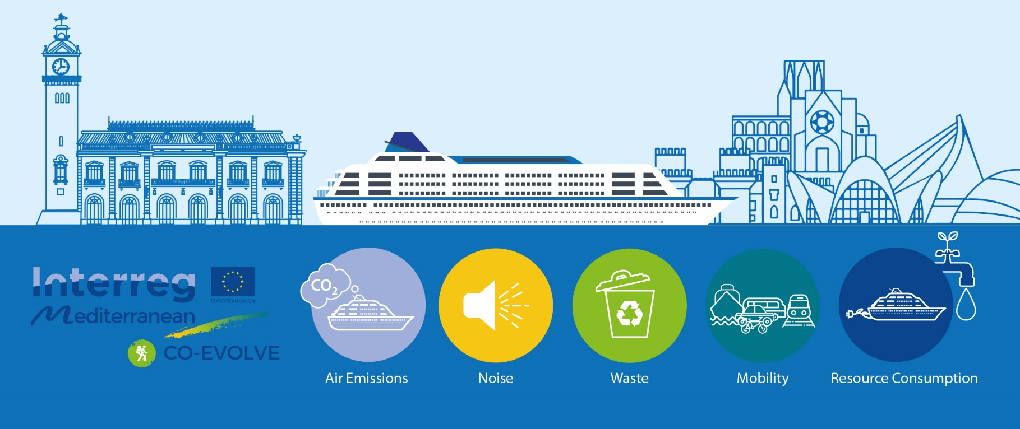
PA4 – Environmental impact of cruise ship industry

Slide 22

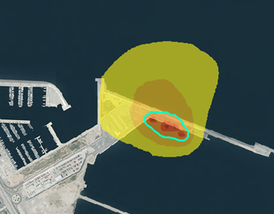
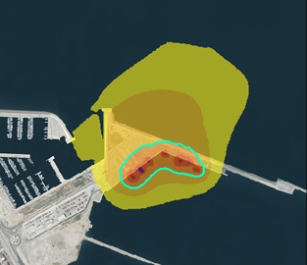
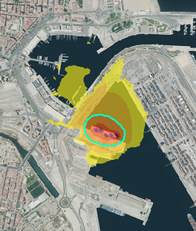
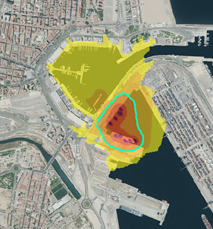
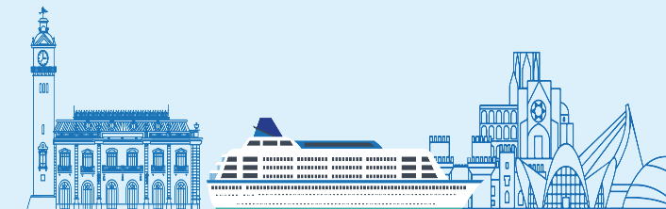
PA4 – Noise impact simulations
1 ship
2 ships
OCA 55 dBA
OCA 55 dBA
1 ship
2 ships
OCA 55 dBA
OCA 55 dBA
Notes:
Calidad acustica ciudad a partir de la linea verde, considerando la medida para zona residencial.
El análisis del mapa de isófonas revela que:
En el muelle de Cruceros la propagación sonora es mayor debido a que se produce en campo libre al no haber obstáculos.
En el muelle de Poniente existen edificios que condicionan la propagación del sonido, reduciéndose la distancia del impacto acústico.
La propagación de ruido del buque oscila entre 100 y 600 metros (rango que nos ofrece la isófonoa 45-50 dBA), si bien también va a depender de las condiciones atmosféricas que se produczan en cada momento.
Por tanto se observa que se cumplen los objetivos de calidad acústica para las zonas residenciales más cercanas, no superándose los 45 dBA (objetivo fijado para el periodo nocturno).

Slide 23
PA4 – Passenger mobility
City Centre
*
*(Fuente: Estadísticas de Turismo 2017. Turismo Valencia)
Notes:
382.799 crueristas 2017 menos del 20% de los turistas

Slide 24
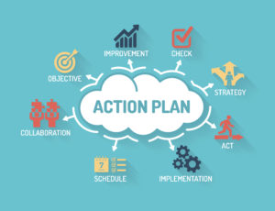
PA4 – Valencia Action Plan
Strategic goal: Maximizing local economic benefits from cruise tourism
Strategic goal: Improving the institutional framework and policies affecting sustainable cruise activity
Strategic goal: Reducing the environmental impact caused by cruise shipping industry
Notes:
382.799 crueristas 2017 menos del 20% de los turistas

Slide 25

Thank you
christian.marasmi@regione.emilia-romagna.it

